Slide 1
Energy

Slide 2
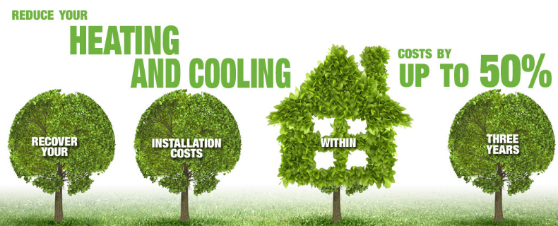
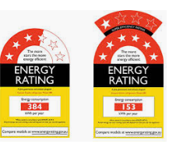


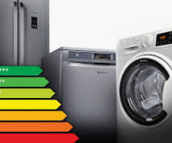
Think to yourself what concept these pictures may be representing

Slide 3
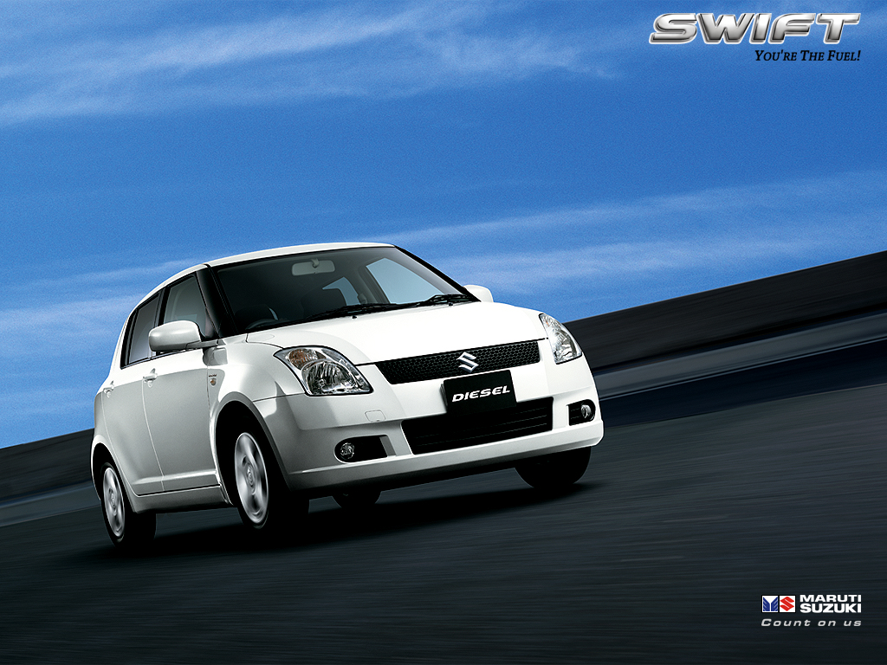
Does what you were thinking match up with these examples of the concept
A clothes dryer converts most of its electrical energy to heat energy
A person is frustrated that their washing machine is wasting most of its energy as heat and sound
A person swaps to a diesel car so they can get more kinetic energy from the chemical energy provided by fuel

Slide 4
These are more examples
A car converts 30% of its chemical energy as kinetic and loses 70% as heat, sound and light.
An athlete converts 10% of their chemical energy into kinetic.
A fridge wastes 68% of its energy on sound and heat.

Slide 5
What is the concept?
Energy efficiency: The percentage of total energy input that is consumed in useful work and not wasted.

Slide 6
Fill in the blanks on your worksheet
Energy Efficiency
Example | Initial Energy | Useful Energy | Wasted Energy
Car accelerating | Chemical | Kinetic | Heat + Sound
A fan | Electrical | Kinetic | Heat + Sound

Slide 7
How to calculate Energy Efficiency
Energy Efficiency = Useful Energy x 100
Total Energy Worked Example: A hairdryer starts with 600J of electrical energy and uses 350J as heat energy.
350/600 x 100 = 58.3%Efficient

Slide 8
Fill in the blanks and then complete your worksheet
Energy Efficiency
Example | Useful Energy | Total Energy (input) | Efficiency
Car accelerating | 10 000 J Kinetic | 35 000J Chemical
A fan | 150J Kinetic | 400J Electrical

